Slide 1

Employee Attrition PROJECT
HASh ANALYTICS
Precious Onu
arnoldsimplicity@gmail.com

Slide 2
Project stages
Data exploration
Data Insight
Model Development

Slide 3
Data Exploration
Dataset | Date received | Individuals (Rows) | Variables | Value Count
Existing employees | 14/04/2020 | 11,428 | 10 | 114280
Employees who have left | 14/04/2020 | 3571 | 10 | 35710
Department field (variable) in the dataset has 10 unique values; sales, accounting, hr, technical, support, management, IT, product management, marketing, R&D.
Salary has three values; low, medium and high.
Promotion within the past 5 years and Work accidents have values which represent Booleans. 0; False and 1; True.
Low | Medium | High
2172 | 1317 | 82
Boolean | Promotion (5 years) | Work accidents
0 (False) | 3552 | 3402
1 (True) | 19 | 169

Slide 4
Data Exploration
Exploratory data analysis to understand the data structure
Visualizations of variables over individuals to identify visible trends
Histograms, Columns charts, Scatter plots and Pie charts are used to gain insights into the data

Slide 5
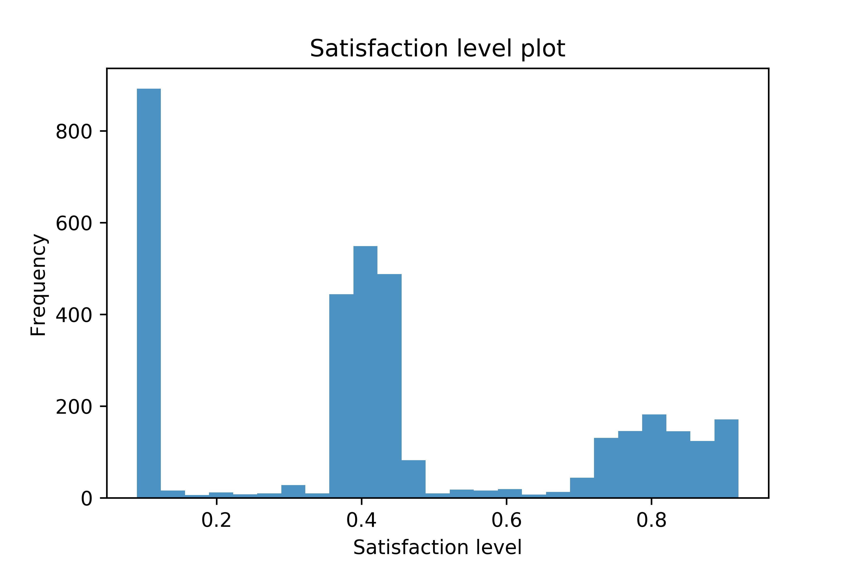
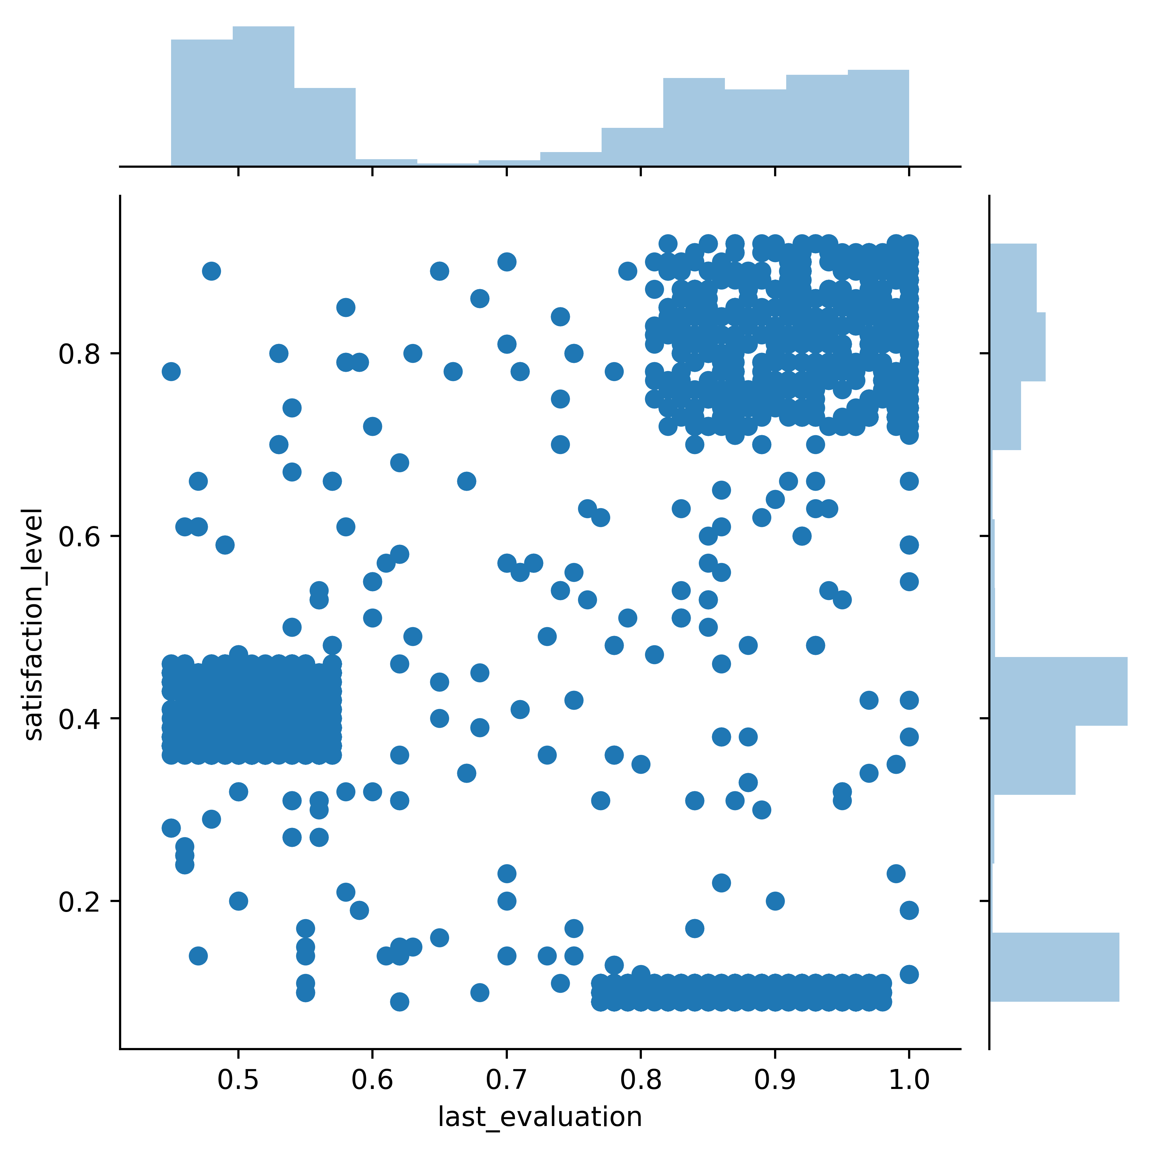
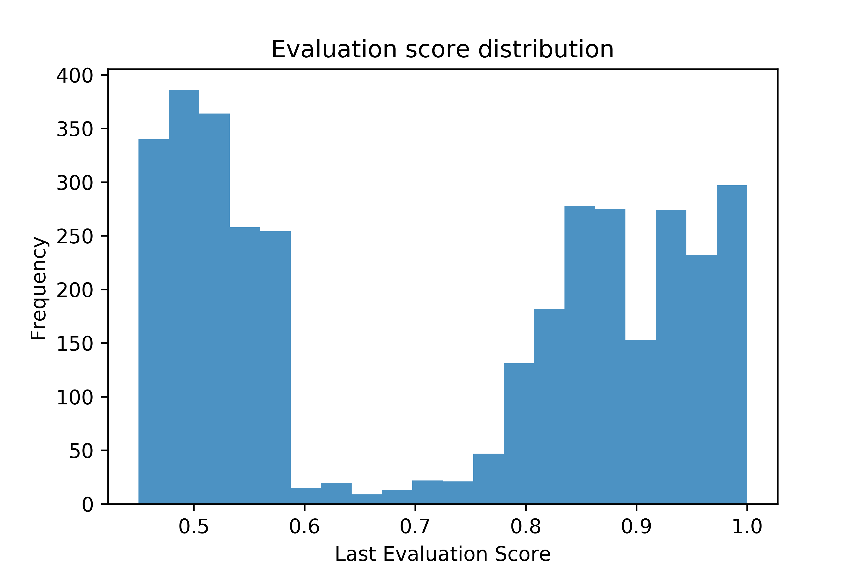
Data Insights

Slide 6
Data Insights
Satisfaction level plot histogram is multimodal.
Least satisfied employees are most likely to leave (satisfaction <0.2)
Employees with an average satisfaction of 0.4 have the next highest exit rate
Employees over the large satisfaction spread (0.75-0.9) have the next high cumulative exit rate
Last evaluation score histogram is bimodal.
Employees with an average evaluation score of 0.5 are more likely to leave
Cumulative spread over the range of 0.8 to 1.0, accounts for most exits from the company

Slide 7
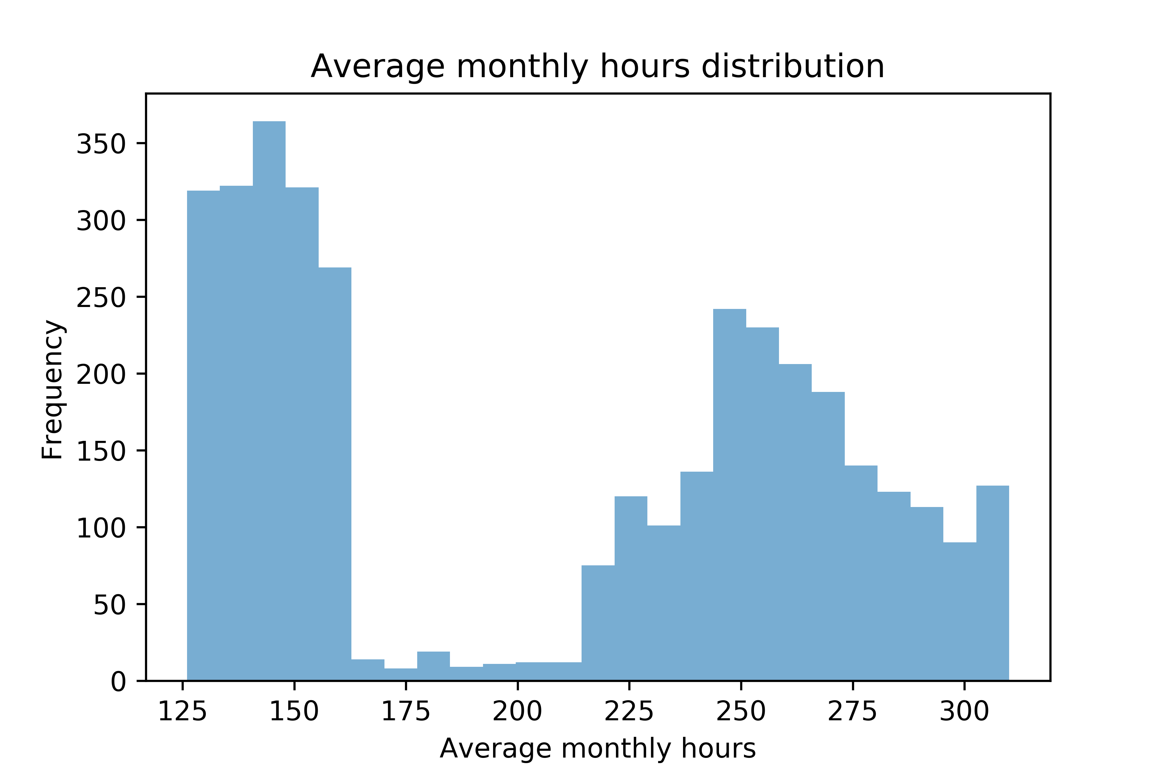
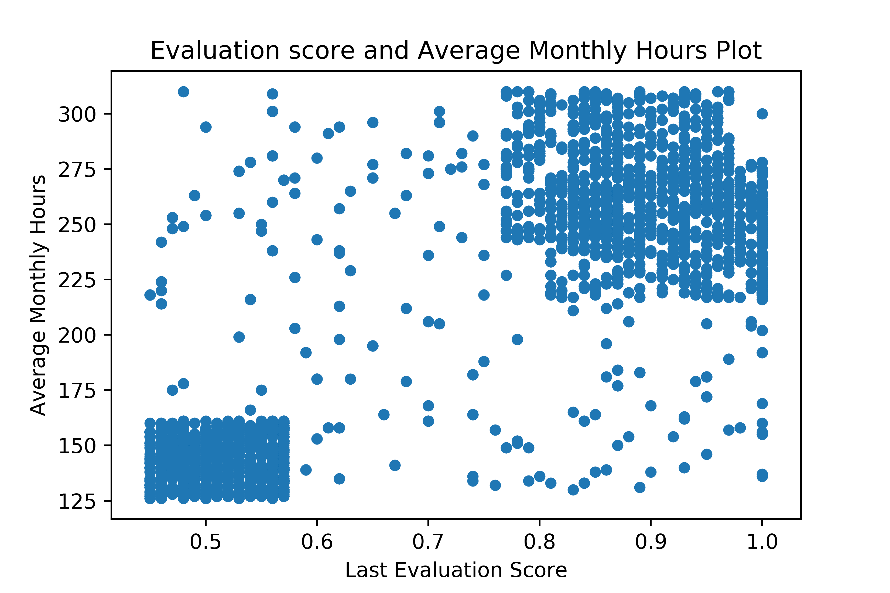
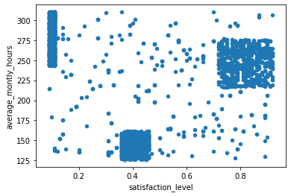
Data Insights

Slide 8
Data Insights
Satisfaction to average monthly hour plot:
Least satisfied employees (0.2) work an average of 250-300 hours per are likely to leave
Average satisfied employees (within 0.4) are next likely to leave, and
highly satisfied employees (within 0.8) who work long hours (within 250-275 monthly average hours)
Last evaluation score plot to average monthly hour reveals:
Employees’ highest attrition are those with low evaluation score, and works between 125-165 average monthly hours
Highly evaluated employees who exit, work between 220-300 hours. Those most likely to exit amongst them are employees who work a monthly average of 250 hours

Slide 9
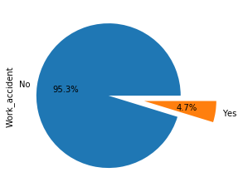
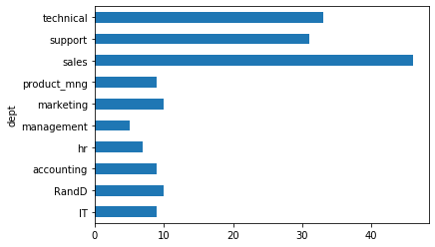
Data Insights
4.7% of employees who left the company have had accident while working
The number of recorded work accidents from employees who have left the company was more in the sales department, then technical and support.

Slide 10
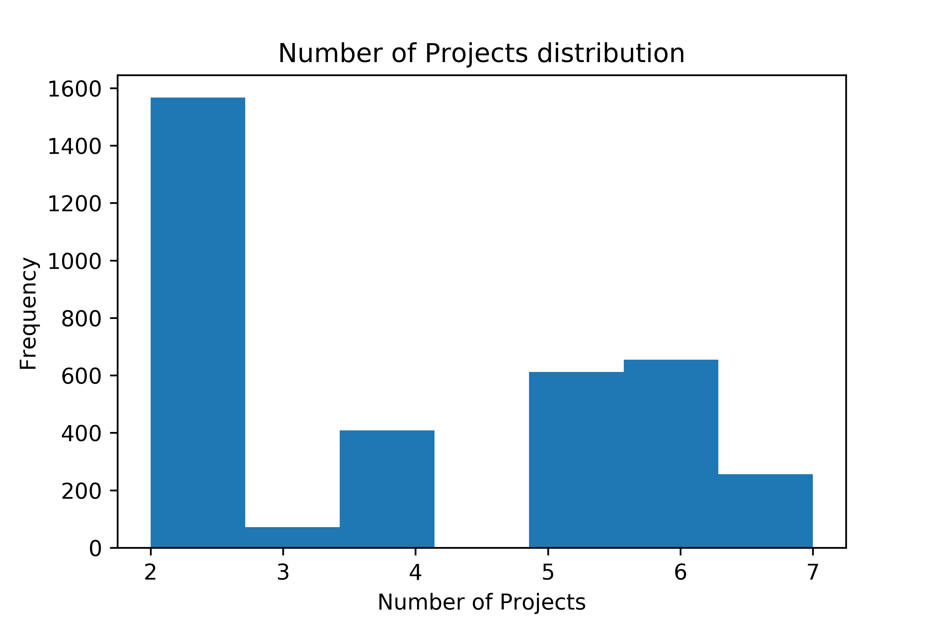
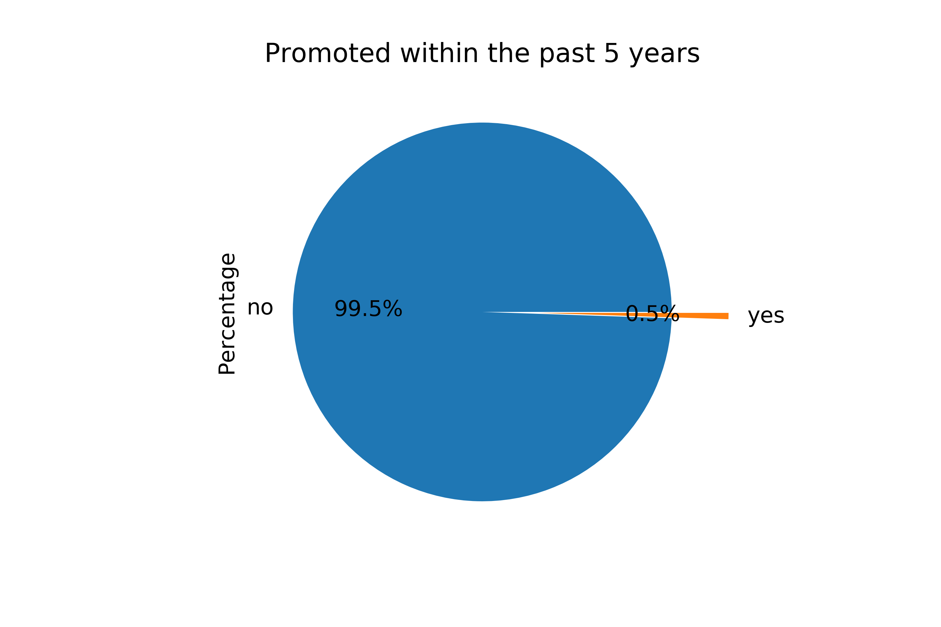
Data Insights
Those with the least projects, on an average of 2, tend to leave the company
99.5% of those who exit the company have not been promoted within the past 5 years

Slide 11
Data Insights
Those with the least projects, on an average of 2, tend to leave the company
99.5% of those who exit the company have not been promoted within the past 5 years

Slide 12
Model Development
The problem is a classification problem (to predict if an employee is likely to leave or stay)
The variables satisfaction level, promotion within the past five years,
department, number of projects, average monthly hours worked, last evaluation score, work accidents, salary and
Time spent in the company would be used to develop the predictive model to determine if an employee is likely to exit the company
Random Forest Algorithm is used to develop the model with an n_estimator of 71

Slide 13
Model Development
The training accuracy score is 100%
The testing accuracy score was 99%. Only 4 Type II error were recorded

